Slide 1
Ra
Android version of the boardgame
By Benjamin Sklar

Slide 2
Ra
3-5 player boardgame
Auction based
Players accumulate tiles via auctions and score their tiles at end of each of 3 epochs. Tiles are grouped into various categories.
Game description: http://boardgamegeek.com/boardgame/12/ra
iOS version description: https://videogamegeek.com/videogame/86774/reiner-knizias-ra
Source: https://github.com/brskl/Ra

Slide 3
Activities
Main (Launcher)
NewGame – setup a new game
Game – game play
Tiles – detailed info, tiles collected by all players
Score – score for epoch and final score

Slide 4
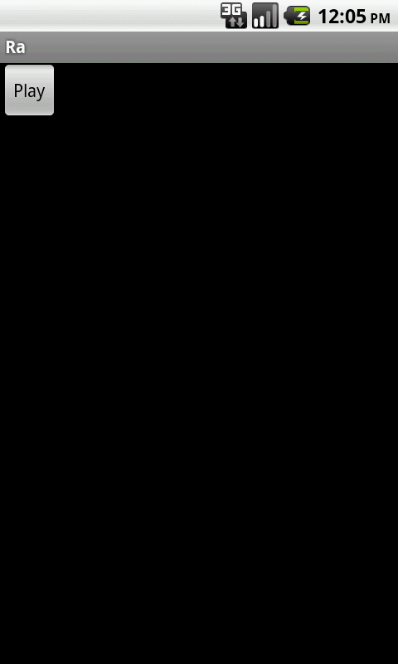
Main
First screen seen
ToDo:
Add Splash-Screen prior
Add additional graphics
Add additional buttons for: leaderboards, matchmaking

Slide 5
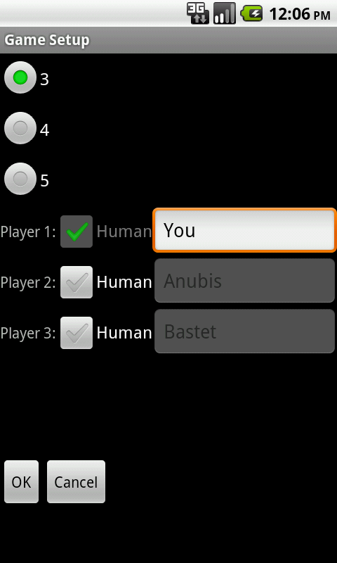
New Game
ToDo:
Improve appearance
Check checkbox to ToggleButton or Switch (AI/Human)
Add functionality to select AI player (difficultly and ‘personality’)

Slide 6
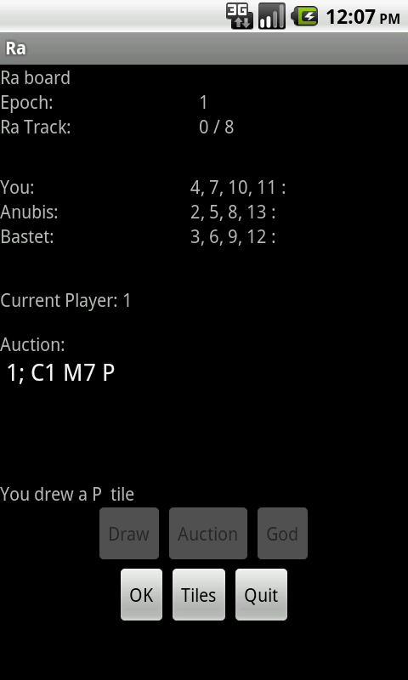
Game
Main game play screen
Player can draw a tile or start an auction.
Insufficient space to show tiles players have accumulated so far. So have ‘Tiles’ activity

Slide 7
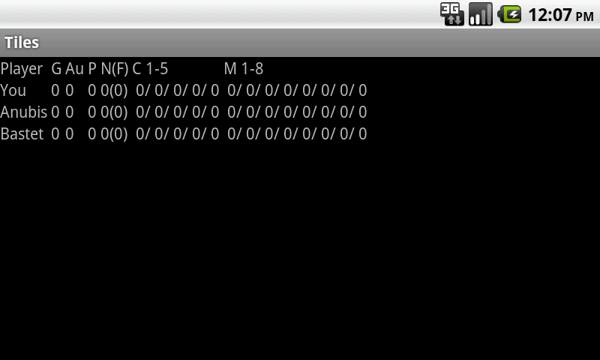
Tiles
Detailed information showing tiles already accumulated by players

Slide 8
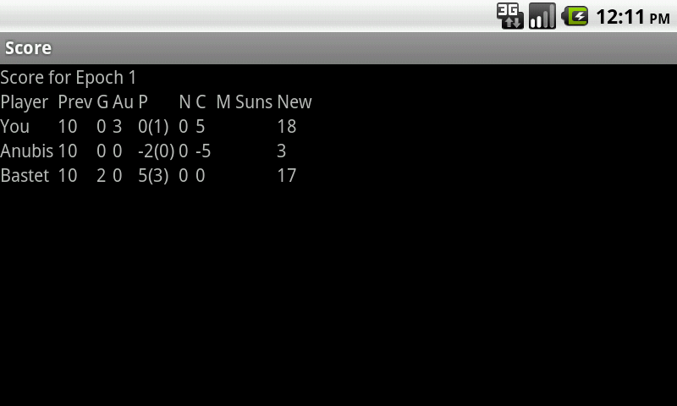
Score
Display score separated by categories for each player.

Slide 9
features used
RadioGroup/RadioButton
Checkbox
EditText
Button
TextView
LinearLayout / nested LinearLayout
TableLayout / TableRow (not from class)
SharedPreferences

Slide 10
Issues
Difficult to represent all information on limited screen space. What is best way to represent and organize in useful manner? With board game it is easy to see all information, whereas on device it is necessary to have a separate screen to display the tiles players have accumulated
How to write in extensible manner so that networking can be easily added.
Without graphical representation, theme is lost.

Slide 11
ToDo
Improve overall visual appearance
Replace textual representations of tiles and bidding tokens with graphics
Write reasonable AI players
Add networking with other devices for multiple human players
Add matchmaking
Add custom settings (separate from NewGame items)
Add save game (solo only) so that play can be interrupted

